Slide 1
Sprint Review #2
SPP400

Slide 2
Discussion of Successes (Retrospective)
Steady burndown rate, all issues completed
Helped out by 24 hour pull request policy
Improved code coverage, up to 95% from 92%
Scrums more frequent and effective through discord

Slide 3
Discussion of Failures (Retrospective)
Poorly defined minimum viable product at the beginning of the sprint
Some issues were poorly defined (dependencies)
BDD was not taken as seriously as it should have been

Slide 4
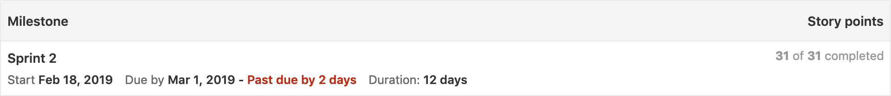
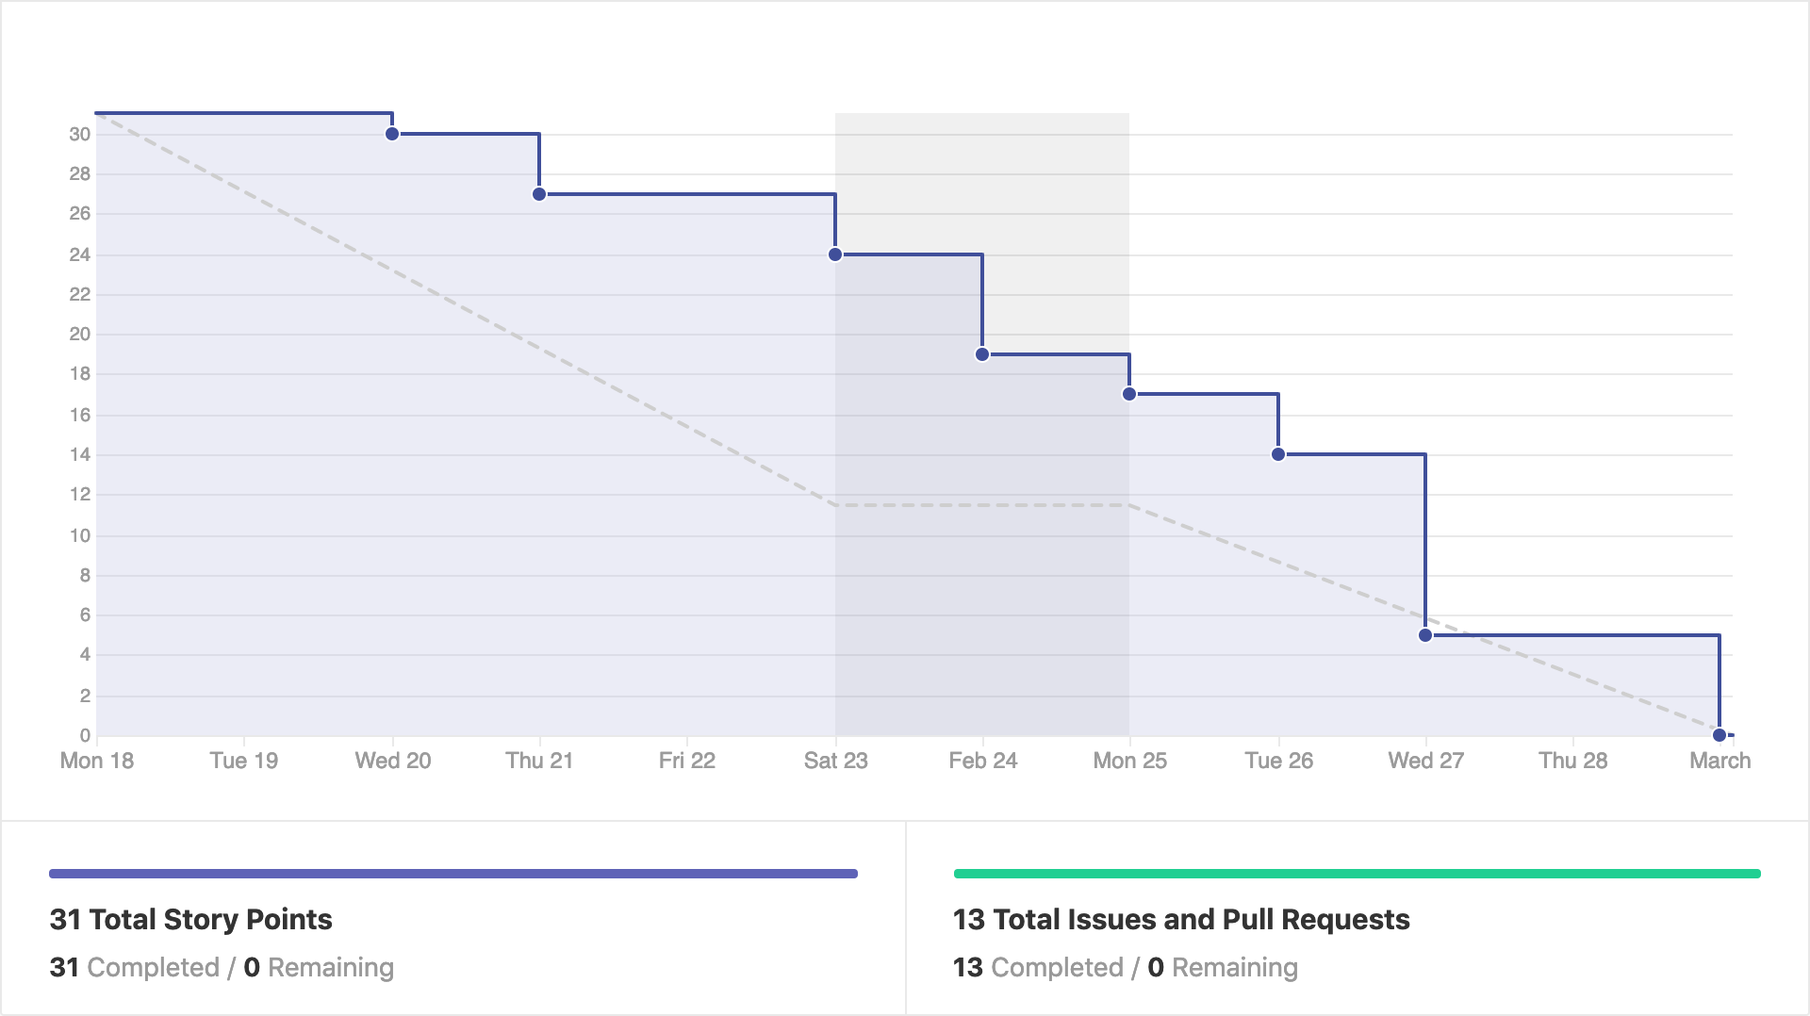
Velocity and Burndown Report

Slide 5
Changes for Sprint 3 (Retrospective)
Better defined issues and minimum viable product
Further develop BDD testing
Better week 1 burndown

Slide 6
Review of Accomplishments
Set up index pages for patients and procedures
Table view of each patient and procedure, links to their individual pages
Updating and deletion of patients and procedures
Follow a link from the patient/procedure profile to access a page where information can be edited
Set up navigation bar with desired pageflow links

Slide 7
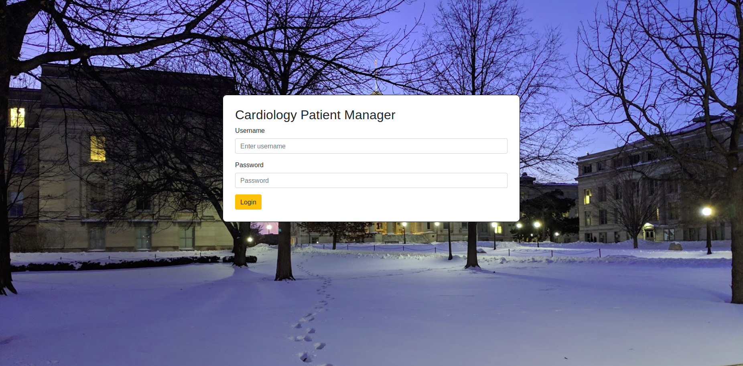
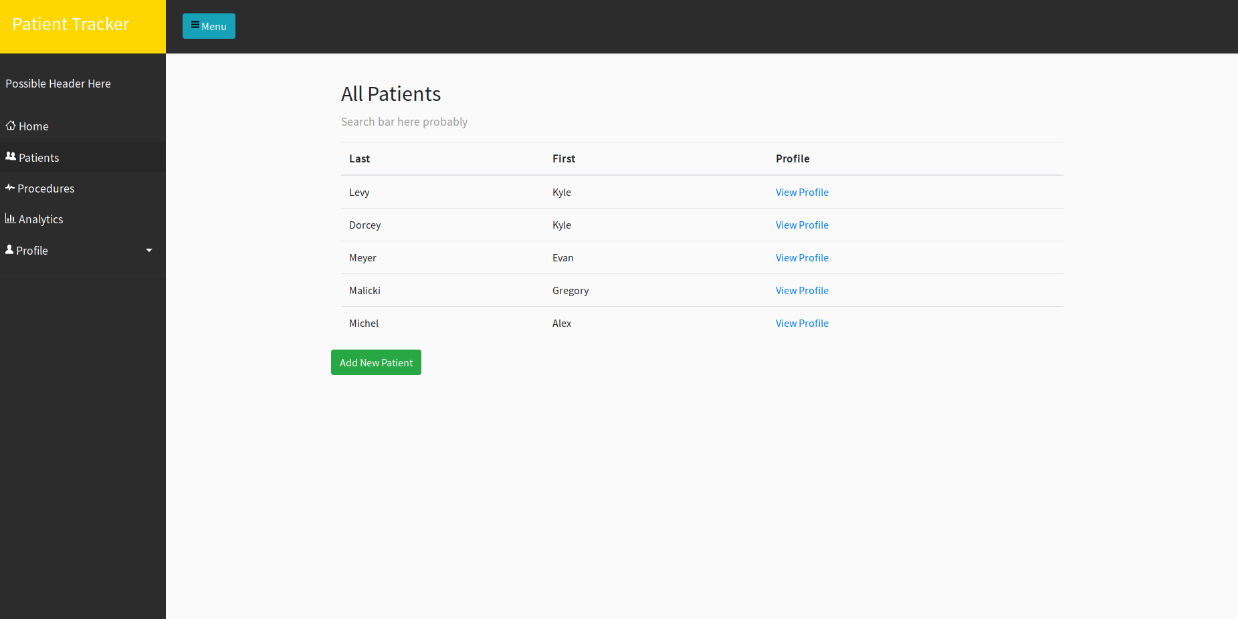
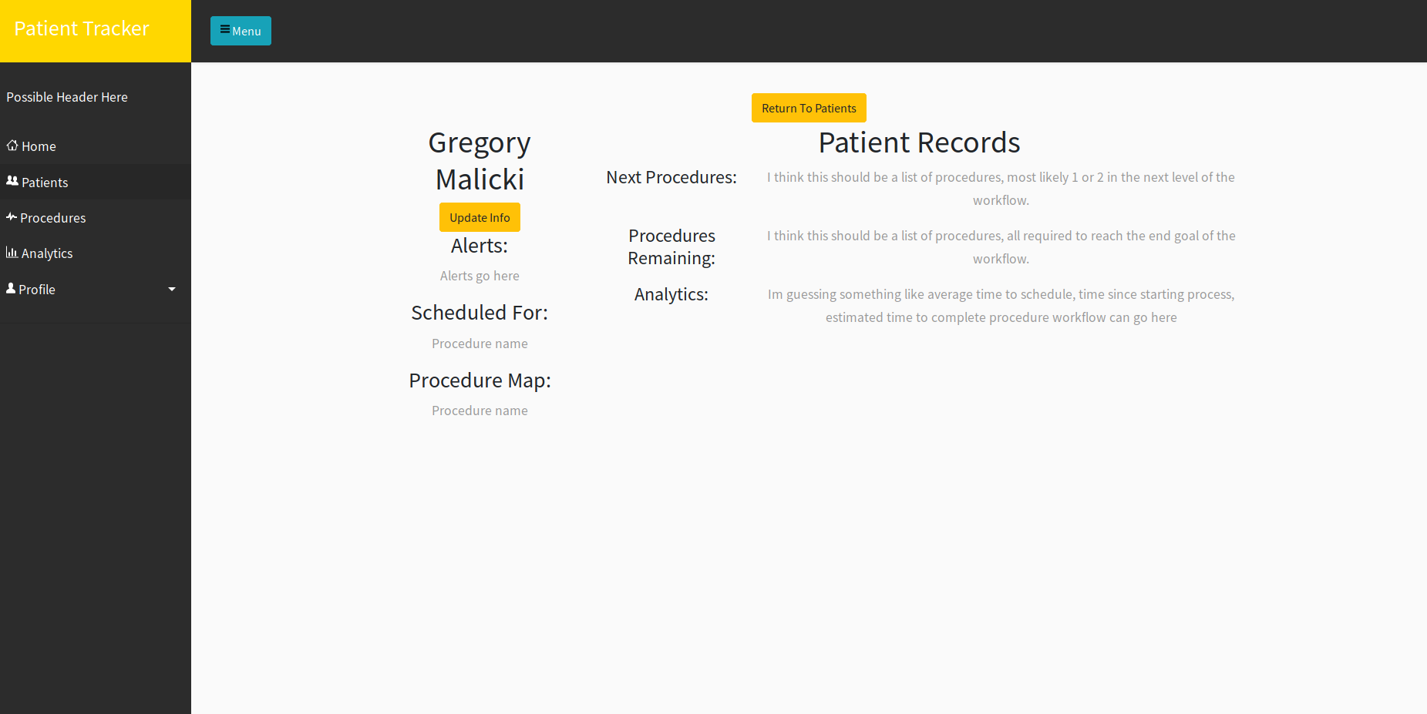
Screenshots of current iteration

